Slide 1
Lecture - Dec 1, 2015
Receptor-mediated Entry of HIV-1 into Cells:
A Target for Prevention and Treatment Purposes

Slide 2
What was unusual about the bone marrow stem cells transplanted into the “Berlin patient” Timothy Brown?
a.) They were MHC-matched
b.) They were MHC-mismatched
c.) They lacked a functional CCR5 gene
d.) They lacked a functional CD4 gene
e.) They were obtained from his partner

Slide 3
What do we hope to learn today?
HIV and SIV are unusual compared to other families of viruses in that they use a sequential two receptor system for entry into their target cells
To what extent can virus-receptor interactions become the target of drug development
A discussion of the pioneering paper by Gardner et al

Slide 4
Families of Viruses
DNA RNA RNA
Adenoviruses Reoviruses Retroviruses (env)
Papovaviruses Picornaviruses Bunyaviruses (env)
Papillomaviruses Arenaviruses (env) Filoviruses (env)
Parvoviruses Togaviruses (env) Coronaviruses (env)
Herpesviruses (env) Calciviruses Astroviruses
Poxviruses Flaviviruses (env) Bornaviruses (env)
Hepadnaviruses (env) Orthomyxo (env) Rhabdoviruses (env)
Paramyxo (env)

Slide 5
Receptor-mediated
↙ fusion
Receptor-mediated
endocytosis ↘

Slide 7
The HIV/SIV Envelope Glycoprotein complex
L
SU (gp120)
TM (gp41)
CD
SU
TM
CD
Notes:
An important characteristic of the gp41 cytoplasmic domain in lentiviruses is that is very long comparing with the other retroviruses and the function of this long cytoplasmic tail are not completely understood.

Slide 8
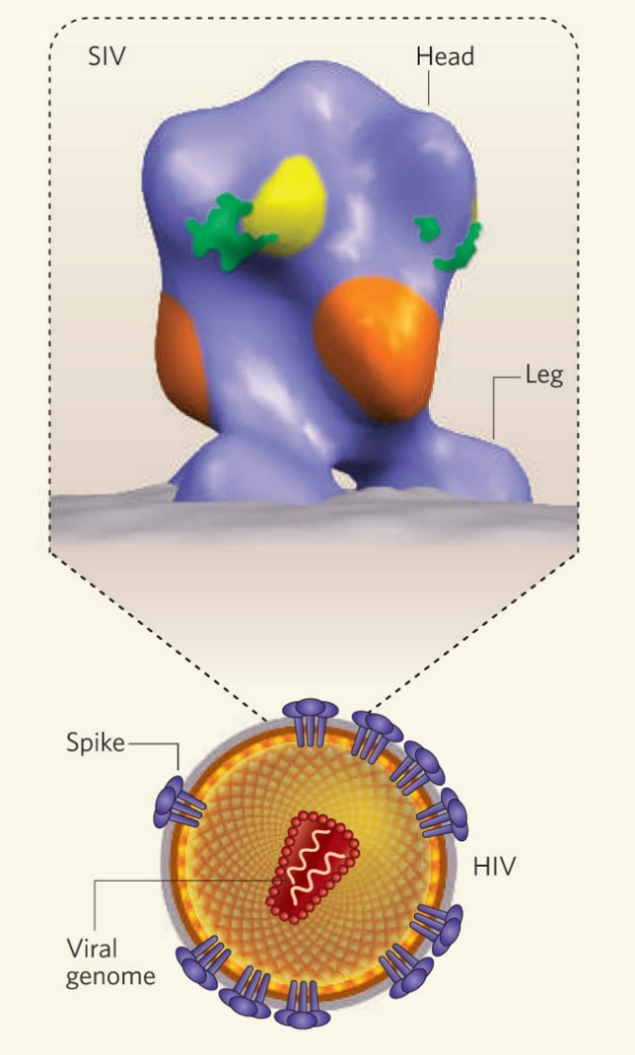
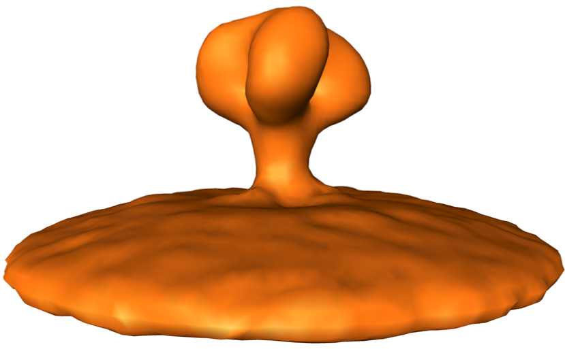
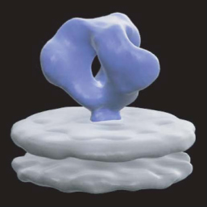
Antibodies that bind to HIV spikes neutralize the virus
Zanetti et al, 2006, PLoS Path Aug;2(8):e83
Zhu et al, 2006, Nature 441, 847.
Liu et al, 2008, Nature 455, 7209.

Slide 9
←←←←← T20

Slide 10
Envelope Glycoprotein Complex is “Spring-Loaded”
The envelope glycoprotein complex must be maintained in a stable, pre-fusion configuration in order to retain infectivity
Premature triggering, triggering that is not appropriate in space or time, results in loss of infectivity

Slide 11
Envelope Glycoprotein Complex is “Spring-Loaded” -continued
It is the receptor-binding surface subunit that is responsible for maintaining the stable, pre-fusion configuration for most viruses
For many viruses, the dramatic conformational changes that lead to fusion result in shedding of the receptor-binding surface subunit

Slide 12

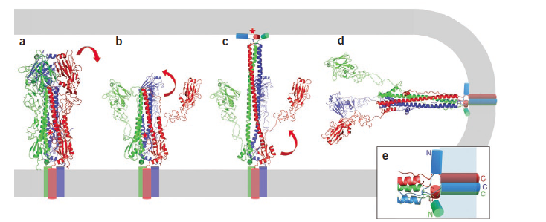
Viral membrane fusion
By Stephen C Harrison
volume 15 number 7 JULY 2008 nature structural & molecular biology

Slide 13
Alternate co-receptors
**** CCR5
** CXCR4
CXCL6
CCR3
others

Slide 14
CCR5 - an interesting protein
A “chemokine receptor” that naturally binds specific “chemokines” resulting in cellular activation and chemotaxis
Totally dispensable for a healthy life
CCR5 knockout mice are perfectly fine
CCR5 “knockout humans” (Δ32 homozygotes) are perfectly fine

Slide 15
CCR5 “knockout humans” - an interesting story
MSM in NYC who were practicing high risk activities and who did not become HIV-infected were investigated. Some were found to have non-functional CCR5 genes.
The defect is a 32 base pair deletion
The allelic frequency of the Δ32 deletion is 10% in those of northern European descent
1% of humans of northern European descent are Δ32 homozygotes
The Δ32 mutation is absent in those of other descents from other parts of the world
Δ32 homozygotes are highly resistant to the acquisition of HIV-1

Slide 16
What’s with Δ32?
The estimated time of emergence of the Δ32 mutation in humans and the locations of highest Δ32 prevalence in Europe have been linked to the height of the bubonic plague in the middle ages
It has been suggested that the Δ32 mutation confers resistance to bubonic plaque and was selected for by the massive epidemic of Yersinia pestis in the middle ages
More recently it has been suggested that smallpox could have been the selection factor for the emergence of Δ32
If you were a researcher interested in this question . . .

Slide 17
Timothy Brown - the Berlin Patient
functional cure
vs.
sterilizing cure

Slide 18
Targeting receptor-mediated entry for development of anti-virals

Slide 19
>20 drugs are currently licensed for the treatment of HIV-1 infection
Reverse Transcriptase (Pol)
  NRTI (7)
  NNRTI (5)
Protease (Pol) (8)
Integrase (Pol) (3)
Env
  T20
  Maraviroc

Slide 20
New Targets for Ongoing
Drug Development Efforts
Vif
Tat
Rev
Env

Slide 21
Targeting receptor-mediated entry for development of anti-virals
Small molecule inhibitors (“drugs” in the classic sense)
Antibodies directed to the receptors
Receptor decoys

Slide 22
Small Molecule Inhibitors
CCR5
  Maraviroc. (Selzentry). Licensed for use. Binds to CCR5 and blocks entry of HIV-1
  Vicriviroc. Investigational. Similar to Maraviroc.
CD4
  Fostemsavir (BMS-663068). Investigational. Completed phase 1 – 2b trials and phase 3 trials are underway. Binds to gp120, blocks binding of virion spikes to CD4, prevents virus entry into the cell. “First in its class”.

Slide 23
Antibodies directed to receptor
CD4
  Ibalizumab. (TaiMed Biologics. David Ho, Founder and CSA). A humanized mAb that binds to domain 2 of CD4. Investigational. Completed Phase 1-2b trials. Further testing is on hold while Dr Ho et al attempt to create a more potent, longer-lived derivative that can be administered subcutaneously. “I don’t want that thing hanging off my CD4s”
CCR5
  PRO 140. (CytoDyn). A mAb that binds to CCR5 and blocks entry of HIV. Investigational. Phase 1-2b trials completed and heading to phase 3 trials.
  Research is underway to develop potent bi-specific antibodies that include PRO140 for development.

Slide 24
Receptor Decoys
CD4
  Soluble CD4 (sCD4). Early clinical trials of sCD4 and sCD4-Ig were not sufficiently promising to warrant further testing. Difficulty in achieving therapeutic doses. Expense. Delivery.
CCR5
  See Gardner et al Nature 2015

Slide 25
Virus neutralization
assay
SEAP
Activity

Slide 26
5 MARCH 2015 | VOL 519 | NATURE | 87

Slide 32
Humble Conclusion of Matt
Gardner and Michael Farzan
Our data suggest that AAV-delivered
eCD4-Ig can function like an effective HIV-1 vaccine.

